Slide 1
Leadership Alliance COVID-19 Economic Response, Recovery & Resiliency Task Force Community Update
July 23, 2020

Slide 2
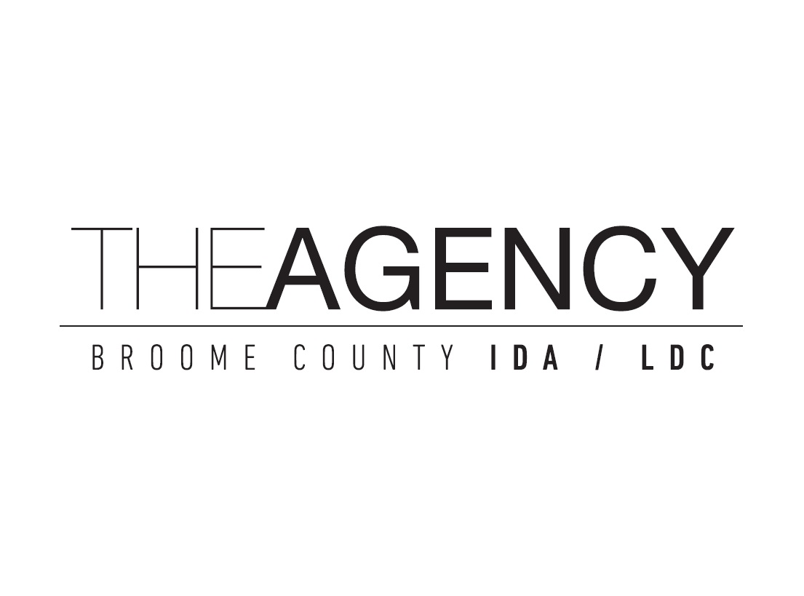
Leadership Alliance The informal merger of The Agency and the Greater Binghamton Chamber of Commerce (November 2019)
Stacey Duncan, Executive Director, The Agency & President & CEO, Greater Binghamton Chamber of Commerce
Brendan O’Bryan, Community Development Specialist, The Agency
Amy Shaw, Chief Operating Officer, Greater Binghamton Chamber of Commerce
Judi Hess, Director, Visit Binghamton, Senior VP for Tourism Greater Binghamton Chamber of Commerce

Slide 3
What is the Task Force?
A collaborative of economic development, industry representatives, education, philanthropic and government officials brought together to address the immediate, short-term and long-term impacts of the COVID-19 pandemic and to create strategies to provide for economic recovery.

Slide 4
Business & Economic Continuity Workgroup

Slide 5
Economic Update – “Great Pause”
Q2 data is starting to come live
Economy bottomed out in May, started to rebound in June
Rebound will not be enough to prevent a recession of historical depth
Q1 growth was -5%; Q2 will be substantially deeper
Average Estimates vary from -30% to -50% (all record setting); Avg ~-34%
Max growth forecast is -12.1%; Min growth is -53%
Estimates improved a little, but will probably decline again with infection rates increasing across the nation
Source: US Chamber of Commerce and others

Slide 6
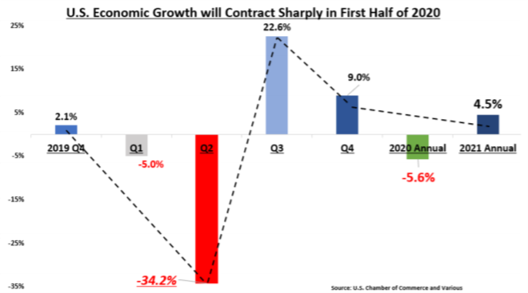
Economic Update – “Great Pause”

Slide 7
Economic Update cont.
Recession should end in Q3 as economy continues to reopen, but this can be affected by new shutdowns
Some forecasts have a 23% growth in Q3; then tapers to 9% in Q4
Not enough to prevent the economy to contract for 2020
Could take at least until mid-2021 to return to it’s size at the end of 2019
Source: US Chamber of Commerce and others

Slide 8
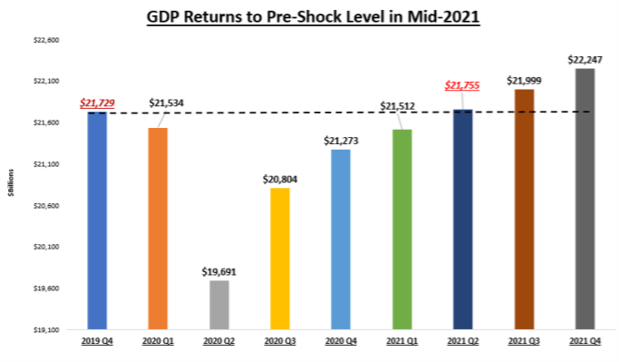
Economic Update cont.
Source: US Chamber of Commerce and others

Slide 9
Economic Data – Consumer Spending
Bottomed out in March, but has seen moderate positive growth since, but much of this has remained stagnant since May
Study was conducted by economists at the University of Chicago
Found that only 7% of the consumer spending behavior in recent months can be attributed by state mandated lockdowns
Vast majority is due to consumer aversion to social interaction
In other words, most people would have avoided restaurants and theatres even if they were home.
This study was conducted by using high-frequency mobility data, comparing the experiences of consumers in locations with sever lockdowns to those with no or limited lockdowns
Study did not find a significant different between the two

Slide 10
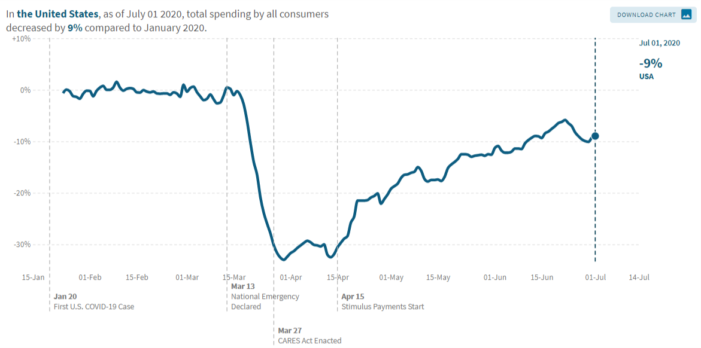
Economic Data – Consumer Spending
Source: Opportunity Insights, Economic Tracker; www.tracktherecovery.org

Slide 11
Economic Data – NYS Data
53% (48% nationally) of adult New Yorkers live in households that have lost employment income
37% expect that they or another household member will lose income soon
44% delayed medical care in the last 4 weeks (significant impact to hospitals)
27% missed last months rent or mortgage payment and fear to miss next
12% are facing food instability
44% of NY small biz expect a return to normal to take more than 6 months
12% do not expect a return to normal levels at all
NYS currently has $6.4 billion in the General Fund, but was bolstered by $5.1B from the Coronavirus Relief Fund
Source: NYS Comptroller

Slide 12
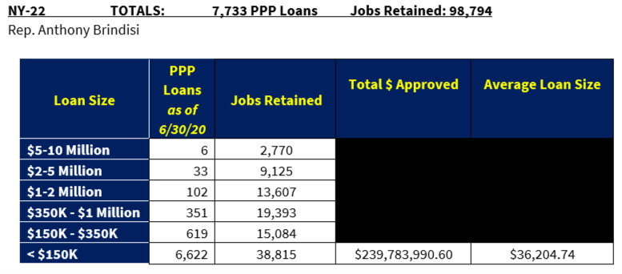
SBA – PPP Loan Update
PPP Loan data is based upon congressional districts (US-22)
Source: Small Business Administration

Slide 13
Local Emergency Loan Update
The Agency
8 Loans
$452,000
City of Binghamton Economic Development Corporation
8 Loans
$100,000

Slide 14
Real Estate - Residential

Slide 15
Real Estate - Commercial
Entertainment & hospitality industries as well as general office space is straining the US Commercial Real Estate Market
Commercial Mortgage-backed Securities (CMBS) market – business side of residential mortgages – are seeing ratings declines and serious increase in delinquencies
Nearly 25% of loans backed by US Hotels were at least 30 days delinquent in June
Delinquency rate for all property types reached 10.32% (all time high of 10.34%)
6.25% of loans were considered “seriously delinquent” for June
Prior to March, overall delinquency rate hovered below 3%
Retail Industry landlords are reporting highest rates of non-payment with nearly half of retail rents going unpaid
Fed has provided some funding to CMBS, but needs more
Source: Axios Media, https://www.axios.com/about

Slide 16
Real Estate - Commercial Good News!
Industrial index is trending positive
Empire State Manufacturing Survey general business-conditions index jumped to 17.2 in July from -.2 in June
First time in the positive since February and higher than expectations
Industrial Real Estate is also in high demand
According to the United States Commercial Real Estate Services (CBRE) industrial space rents increased 1.4% year-over-year in Q2
Leasing activity increased 36% over Q1
Most is due to a tremendous increase in online sales (up by 129%) and the need for large distribution centers
CBRE is expecting this trend to continue
Source: The Central NY Business Journal; United States Commercial Real Estate Services (CBRE)

Slide 17
Economic Data – Looking Forward
This month started Q3 and there are already early indications that in some sectors of the economy, activity is starting to decline
Like due to severe outbreaks in about half of the states with the number of new cases, hospitalizations and deaths rapidly increasing
Some states are reversing reopening orders or halting new openings
States that are renewing or halting restrictions account for about 40% of the US population
NYC is still restricting restaurant/bar access and the state has the mandatory travel quarantine
If there are more lockdowns or extensions, it’s possible that economic activity in Q3 will either grow more slowly than expected, or not grow at all.
Expiration of COVID related relief packages (extra UI, evictions, Mortgage, Student Loans, etc…)
Unknown factor: Congressional Stimulus

Slide 18
Workforce Retention & Talent Attraction Workgroup

Slide 19
Broome County Unemployment Claims
Date
Net Change
# Claims
Year Ago
NY on Pause 3/20/20
3/21/20
3/28/20
4/14/20
4/11/20
4/18/20
4/25/20
5/2/20
5/9/20
5/16/20
5/23/20
5/30/20
6/6/20
6/13/20
6/20/20
6/27/20
7/4/20
7/11/20
+310.2%
+2,110%
+2,410%
+2,303%
+1,189%
+928%
+1,116%
+1,099%
+1,362%
+780%
+453%
+517%
+488%
+527%
+567%
+276%
+290%
1,883
10,565
8,959
8,604
4,332
4,922
4,024
4,534
4,870
3,962
2,936
2,543
1,894
2,218
2,382
2,288
2,038
459
478
357
358
336
479
331
378
333
450
531
412
322
1,046
357
608
522
Phase 1
5/15/20
Phase 2
5/29/20
Phase 3
6/12/20
Phase 4
6/26/20
Source: New York State Department of Labor, Division of Research and Statistics

Slide 20
Unemployment Rate: U.S., NY State, Broome County
(Numbers in thousands, not seasonally adjusted)
20%
15%
United States
10%
New York State
Broome County
5%
0%
March
April
May
June
Source: New York State Department of Labor, Division of Research and Statistics

Slide 21
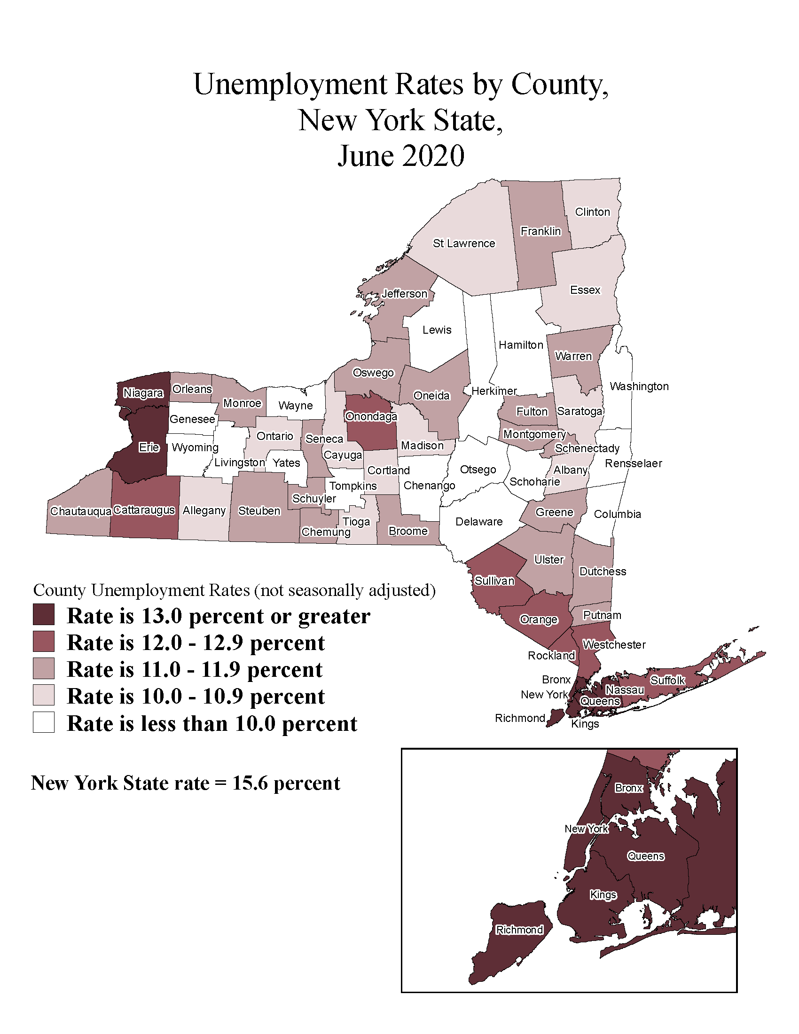
Unemployment Rates by County, New York State

Slide 22
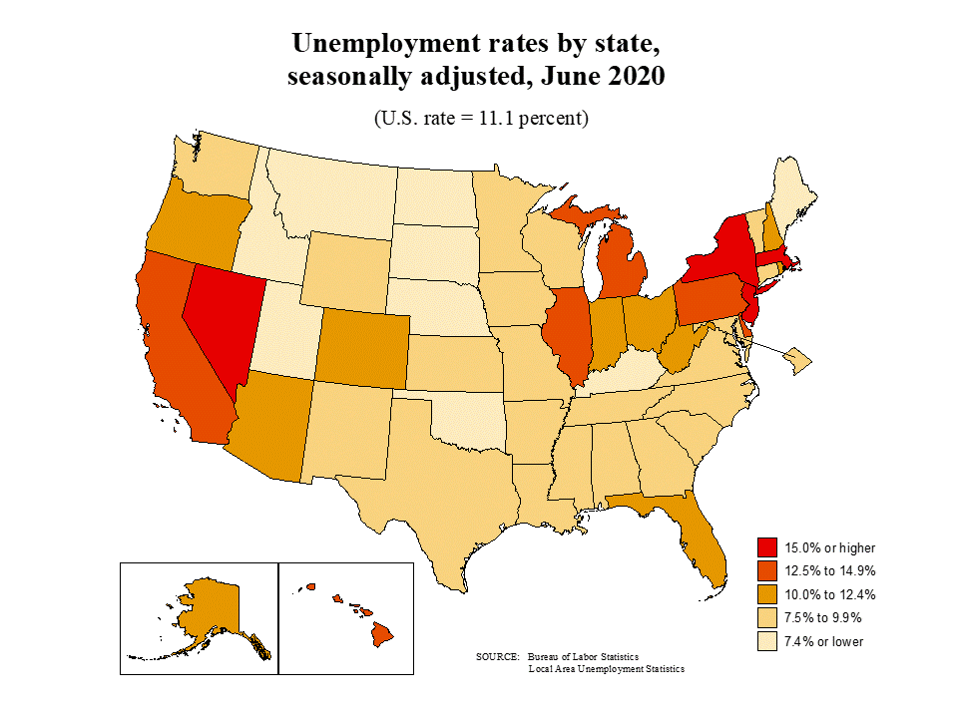
Unemployment Rates by State

Slide 23
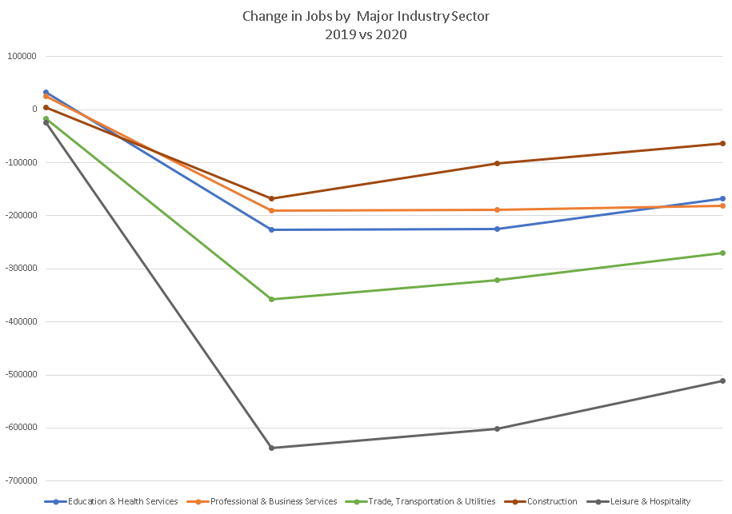
Change in Jobs by Major Industry Sector
MAR
APR
MAY
JUN
Source: New York State Department of Labor, Division of Research and Statistics

Slide 24
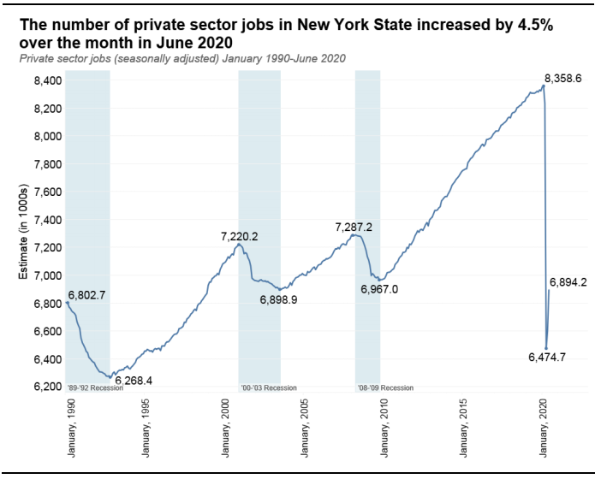
New York State Labor Market Overview – June 2020
Source: New York State Department of Labor, Division of Research and Statistics

Slide 25
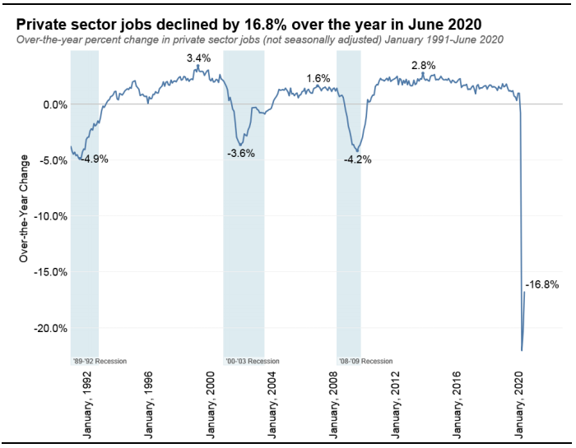
New York State Labor Market Overview – June 2020
Source: New York State Department of Labor, Division of Research and Statistics

Slide 26
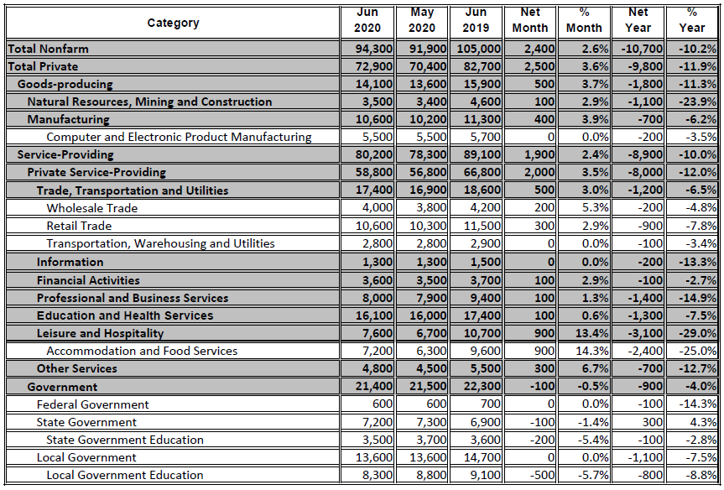
Labor Market Profile Nonfarm Employment BINGHAMTON MSA June 2020, May 2020, June 2019
Source: New York State Department of Labor, Division of Research and Statistics

Slide 27
MetLife & U.S. Chamber of Commerce Small Business Coronavirus Impact Poll
60%
OF SMALL BUSINESSES EXPECT TO RETAIN SAME AMOUNT OF STAFF
Increase
Increase
Remain the Same
Decrease
Decrease
0%
20%
40%
60%
0%
10%
20%
30%
40%
50%
50% of small businesses expect to see an increase in future revenues, compared to 19% that expect next year's revenues to decrease
23% anticipate increasing staff, while 60% plan to retain the same staffing size and 13% plan to reduce staff
Source: U.S. Chamber of Commerce

Slide 28
U.S. Census Bureau Small Business Pulse Survey
FEWER NEW YORK SMALL BUSINESSES ARE SHEDDING EMPLOYEES
40%
Decrease in Employees Over Past Week
30%
20%
10%
Increase in Employees Over Past Week
0%
Week 1
Week 2
Week 3
Week 4
Week 5
Week 6
Week 7
Week 8
Week 9
May 2
May 9
May 16
May 23
May 30
June 6
June 13
June 20
June 27
Source: U.S. Census Bureau

Slide 29
Remote Workforce in Broome County
Of 89,424 occupations, 8,886 are for remote jobs; 23,883 for partially remote jobs; 56,655 for non-remote jobs
TOP REMOTE OCCUPATION JOB OPENINGS
73
47
38
31
26
Software Developers
Network and Computer System Administrators
Accountants and Auditors
Bookkeeping, Accounting, and Auditing Clerks
Sales Managers
Remote
9.9%
Non-Remote
63.4%
Partially Remote
26.7%
Source: Chmura Economics & Analytics

Slide 30
Open Jobs in Broome County
4,400
MORE THAN JOBS AVAILABLE
in a number of different fields from businesses looking to hire immediately
STARTED/NEWLY POSTED JOB ADS IN BROOME COUNTY FROM 3/11-7/11
Retail Salesperson
289
TOP EMPLOYERS WHO POSTED JOBS DURING THIS PERIOD:
Ascension
United Health Services
Wegmans
Lockheed Martin
Stockers and Order Fillers
233
Heavy and Tractor-Trailer Truck Drivers
208
Registered Nurses
205
Customer Service Representatives
132
Cashiers
110
First-Line Supervisors of Retail Sales Workers
107
Social and Human Service Assistants
101
Sales Representatives
92
Janitors and Cleaners
86
0
100
200
300
Source: Chmura Economics & Analytics

Slide 31
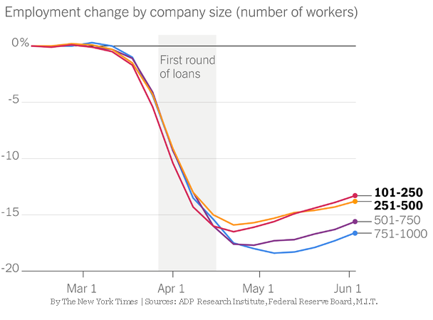
Interesting Data: Back to Work
Small companies - those with fewer than 500 workers - started rehiring workers more quickly than larger companies.
In all, the PPP saved between 1.5 million and 3.5 million jobs, according to a new study by researchers at M.I.T., the Federal Reserve and the ADP Research Institute.

Slide 32
Next Steps…
Merge COVID Workforce Workgroup into Broome Talent Task Force
Evaluate 2017-2020 Strategic Plan
Set New Goals

Slide 33
Tourism & Quality of Life Workgroup

Slide 34
TOURISM COMMUNITY SURVEY
BY THE NUMBERS
TYPE OF BUSINESSES RESPONDING
30%
20%
10%
0%
Attraction/Tour
Cultural Organization
Restaurant/Bar
Retail/Shopping
Hotel/Motel/Accommodation
Entertainment (Theater, Concert Venue, Performing Arts)

Slide 35
TOURISM COMMUNITY SURVEY
BY THE NUMBERS
WHEN DID YOUR BUSINESS REOPEN?
WHAT EFFECTS ARE YOU SEEING?
May: weeks 1-2
Rebookings
May: weeks 3-4
Softening in business
June: weeks 1-2
Postponement
June: weeks 3-4
Cancellations
Still closed
None
0%
10%
20%
30%
40%
50%
0%
25%
50%
75%

Slide 36
STATUS BY TYPE OF BUSINESS
ATTRACTION/TOUR
HOTEL/MOTEL/
ACCOMMODATION
RETAIL/SHOPPING
Opened: May Weeks 1-2
27.3%
Still Closed
25%
Opened: May Weeks 1-2
25%
Opened: May Weeks 1-2
36%
Still Closed
45.5%
Still Closed
43%
Opened: May Weeks 3-4
18.2%
Opened: June Weeks 1-2
25%
Opened: May Weeks 3-4
25%
Opened: May Weeks 3-4
7%
Opened: June Weeks 3-4
9.1%
Opened: June Weeks 1-2
14%
RESTAURANT/BAR
ENTERTAINMENT (THEATER, CONCERT VENUE, PERFORMING ARTS)
CULTURAL ORGANIZATION
Still Closed
24.8%
Opened: June Weeks 1-2
17.9%
Opened: May Weeks 1-2
37.6%
Opened: June Weeks 3-4
12.9%
Still Closed
54.8%
Opened: June Weeks 3-4
27.4%
Closed
100%
Opened: June Weeks 1-2
24.8%

Slide 37
22
Average # of employees
before COVID-19
13
62%
Percentage of respondents that anticipate bringing back all employees
Average # of employees
laid off
$8.09M
Estimated economic impact

Slide 38
Broome County Hotel Occupancy Rate
OCCUPANCY RATE 2019 VS 2020

Slide 39
CANCELLED CONVENTIONS ATTENDANCE AND IMPACT
Cancelled Conventions Attendance and Impact
As of 7/20/2020
AS OF 5/4/2020
ESTIMATED ECONOMIC
IMPACT: $18.8M
2K
1K
925
400
0
125

Slide 40
Travel Sentiment Study – U.S. National Sample
77%
Canceled trip completely
43%
Reduced travel plans
41%
Changed destination to one I can
drive to as opposed to fly
27%
of travelers planning to travel in the next 6 months will change their travel plans due to coronavirus
Changed trip from international
to domestic
20%
0%
10%
20%
30%
40%
50%
Source: Longwoods International Travel Sentiment Study Wave16

Slide 41
Travel Sentiment Study – U.S. National Sample
Travelers With Travel Plans In The Next Six Months Comparison
100%
87%
76%
72%
72%
72%
75%
70%
69%
70%
69%
67%
71%
71%
70%
67%
65%
65%
50%
25%
0%
March 11
March 19
March 26
April 1
April 8
April 15
April 22
April 29
May 6
May 13
May 20
May 27
June 3
June 17
July 1
July 15
Source: Longwoods International Travel Sentiment Study Wave 16

Slide 42
Travel Sentiment Study – U.S. National Sample
Perceptions of Safety and Travel
I support opening up my community to visitors
16%
20%
29%
22%
14%
12%
22%
27%
24%
14%
I feel safe traveling outside my community
I would feel safe dining in local restaurants and shopping in retail stores in my community
16%
19%
24%
27%
15%
0%
25%
50%
75%
100%
Strongly disagree
Disagree
Neutral
Agree
Strongly agree
Source: Longwoods International Travel Sentiment Study Wave 16

Slide 43
Travel Sentiment Study – U.S. National Sample
Influence of Face Mask Requirements* on Destination Choices
I will only visit destinations that require the use of face masks in public
10%
21%
29%
27%
13%
I am more likely to visit destinations that require the use of face masks in public
10%
19%
28%
30%
13%
Face mask requirements have no influence on my destination choice
Not sure/undecided
17%
23%
24%
22%
14%
I am less likely to visit destinations that require the use of face masks in public
I will not visit destinations that require the use of face masks in public
0%
10%
20%
30%
40%
Source: Longwoods International Travel Sentiment Study Wave 16
*In public where social distancing is not possible

Slide 44
Leadership Alliance COVID-19 Economic Response, Recovery & Resiliency Task Force Community Update
July 23, 2020

